Slide 1
Announcements
All participants must register for the Monthly Disease Surveillance Trainings in order for us to provide CMEs:
  Log-on or Request log-on ID/password:
  https://tiny.army.mil/r/zB8A/CME
  Register for FY17 Epi-Tech Surveillance Training: https://tiny.army.mil/r/4TgNE/EpiTechFY17
Confirm attendance for today’s training:
  Enter your full name/email address in the chat box; enter each individual’s information if attending with a group
  You will receive a confirmation email within 48 hours
  Contact your Service Hub if you do not receive this email
Please put your phones on mute when not speaking. Press *6 to mute/unmute your phone.

Slide 2
FOODBORNE ILLNESS FROM A VETERINARY PERSPECTIVE
CW4 Tony Hemphill
Deputy Division Chief, Veterinary One Health Division
July 25, 2017
Notes:
At the end of this brief, participant will have a better understanding of the Structure, Mission Priorities, Roles and Responsibilities, Support provided by US Army Veterinary Services Activities. Participants will also become more familiar with Medical Hold Procedures/Disposition procedures and guidelines.

Slide 3
Learning Objectives
At the end of this briefing;
Understand the structure of the US Army Veterinary Services
Understand Medical Hold Procedures/Disposition
Understand Veterinary Services Food Protection Program Mission Priorities
Understand local level Veterinary Services Activity personnel’s roles and responsibilities in the event of a foodborne illness outbreak
Understand the support provided during a local level foodborne illness outbreak

Slide 4
AGENDA
US Army Veterinary Services Structure
Medical Hold/Disposition
Top Five Food Protection Program Mission Priorities
Roles and Responsibilities
Food Protection Support

Slide 5
VETERINARY SERVICES
Structure
US Army Veterinary Services mission consist of both an animal health and a food protection mission
Veterinary Service personnel include;
Veterinary Corps Officers (Branch Officers and Warrant Officers), Veterinarians and Food Safety Officers
Veterinary Food Inspection Specialist (MOS 68R) and Animal Care Specialist (MOS 68T)
Veterinary Services Regional Headquarters
Public Health Command-Atlantic
Public Health Command-Central
Public Health Command-Europe
Public Health Command-Pacific
With Veterinarians service in other organizations/agencies (i.e. NAVSUP)
Notes:
The US Army Veterinary Services mission includes both animal health and food protection worldwide. Veterinary Services is a unique Corps, because it provides support to all the Services. On Army, Navy, and Marine installations support consist of animal health and food protection related support and on Air Force bases, animal health is the main type support provided.
Here’s the personnel structure
- What is the process for Navy to enlist the assistance of Vet Services during an ongoing investigation? This might also include an idea of how Vet Services is set up in general (how it is organized and such).
Coordination for support can be accomplished through your local Veterinary Service Activity or through their Higher Headquarters.
There are four geographically located regional Veterinary Service Headquarters that oversee the VS global mission. They’re listed here.
• Public Health Command-Atlantic (Responsible for the Eastern States)
• Public Health Command-Central (Responsible for the Central States and a few Southwestern locations)
• Public Health Command-Europe (Responsible for the Europe, UK, and Africa)
• Public Health Command-Pacific (Responsible for the Pacific and some Western States)
- How do line entities like the Fleet get included in these processes like med holds?
These questions spurred from the Navy side due to NEPMUs following an investigation they supported which turned out to be part of a larger multi-state investigation. The investigation led to the belief that several food items were causing salmonella illnesses across the US but they found a knowledge gap when it came to working with Veterinary Services and felt that this would be a good topic to cover.

Slide 6
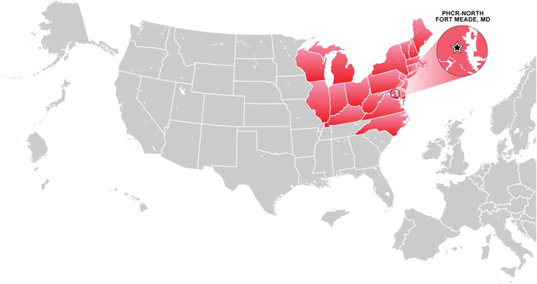
PUBLIC HEALTH COMMAND - ATLANTIC
PHC-ATLANTIC
Contact Information
Name: PHCR-North
Email Address: usarmy.meade.medcom-phcr-n.list.web-contact@mail.mil
Telephone: 301-677-6502
DSN: 622-6502
Mailing Address: Public Health Command Region-North
ATTN: MCHB-RN
4550 Llewellyn Avenue
Fort George G. Meade, MD
20755-5225

Slide 7
Public Health Command-Pacific
PHC-PACIFIC VETERINARY SERVICES DIVISION
Emergency Contact - Staff Duty Officer
Local: 090-1839-1494
From CONUS: 011-81-901-839-1494
Contact Information
Name: PHCR-Pacific Headquarters Japan
Email Address: usarmy.zama.medcom-jpn.list.phcr-pacific-cmd@mail.mil
Telephone: From CONUS 011-81-46-407-8447
DSN: (315) 263-8447
Mailing Address: OFFICIAL:
Department of the Army
USAPHCR-Pacific
ATTN: MCHB-RP
Unit 45006
APO AP 96343-5006
COMMERCIAL (Also our FEDEX Address):
USAPHCR-Pacific
ATTN: MCHB-RP
Unit 45006
Camp Zama, Japan, Bldg. 715
252-0027 Kanagawa Ken, Zama Shi

Slide 8
PUBLIC HEALTH COMMAND REGION-WEST
PHC-PACIFIC VETERINARY SERVICES DIVISION
Public Health Command Region-West
NOTE: As of 17 August 2015, PHCR-West has merged with other Public Health Commands.
Technical services are now aligned under Public Health Command - Pacific (Provisional).
The San Diego and Joint Base Lewis-McChord districts have transitioned to Public Health Command - Pacific
The Fort Carson district transitioned to Public Health Command - Central (Provisional)
The information here is provided as a courtesy and may not be up-to-date.

Slide 9
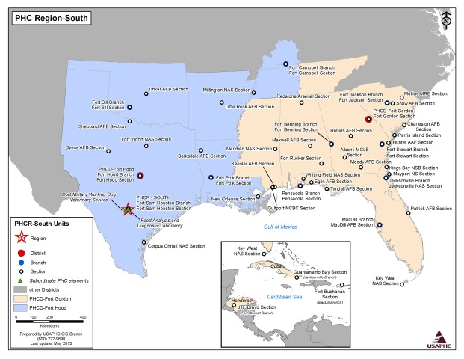
PUBLIC HEALTH COMMAND-CENTRAL
PHC-CENTRAL VETERINARY SERVICES
Public Health Command Region-South
NOTE: PHCR-South has merged with other Public Health Commands.
Technical services are now aligned under Public Health Command-Central
Fort Gordon district transitioned to Public Health Command-Atlantic
Contact Information
Name: PHCR-South
Email Address: usarmy.jbsa.medcom-phcr-s.mbx.phcr-south@mail.mil
Telephone: (210) 221-3495
DSN: 471-3495
Mailing Address: Public Health Command Region - South
2899 Schofield Road, Suite 2630
Ft Sam Houston, TX 78234-7583

Slide 10
REGIONAL HEALTH COMMAND - EUROPE
PHC-EUROPE VETERINARY SERVICES
Contact Information
Name: PHC-Europe Veterinary Services
Email Address: usarmy.landstuhl.medcom-phcr-e.list.usaphcre-animal-medicine@mail.mil
Telephone:
06371-86-8956; (+49) 6371-86-8956 (outside Germany)
DSN: 314-486-8956
Mailing Address:
US Army Public Health Command Europe Veterinary Services
CMR 402
APO AE 09180

Slide 11
MEDICAL HOLD/DISPOSITION
All Food/Nonprescription Drug Activity (ALFOODACT)
a. Immediately inventory stocks to identify the above items and secure in a "Medical Hold" status to provide assurance of no further issue/sale/use.
5. POSITIVE AND NEGATIVE FINDINGS:
a. Air Force Public Health personnel involved in the installation pilot program, and Army Public Health personnel, report your negative and positive findings HERE. If you are not in one of these two groups, please use the instructions below (paragraphs b-d). NOTE: The Air Force is currently in a pilot program to utilize the VSIMS Subsistence Recalls application for ALFOODACT responses. Additional installations will be phased in over time. If you have been informed of this responsibility by your MAJCOM PHO or AFMSA, please use the link above. If not, please report your findings in accordance with your current policy.
b. Defense Logistics Agency (DLA) Contractors, report positive and negative findings to your Accountable Officer.
c. Ships at sea are authorized to destroy or dispose of recalled products at their discretion. Documentation for the number of pounds and cases, and any additional pertinent information must be signed by the Accountable Officer and is required for the purpose of recouping to the government the cost of the product involved. In order to get credit please use a SF 364 (For instructions on how to “Properly Prepare a Standard Form” (SF) 364 please use this link: http://www.dla.mil/LandandMaritime/Offers/Services/TechnicalSupport/Logistics/Packaging/PrepareSF364.aspx and forward to your supporting NAVSUP Fleet Logistics Center (NAVSUP FLC) and copy furnished to NAVSUP 51. Your supporting NAVSUP FLC should forward to the account manager at DLA Troop Support. The form should include the number of the recall authorizing the survey action. Home-ported ships/galleys will utilize DD form 1149 to transfer with reimbursement to the PV. The PV will submit credit invoice to the account manager at DLA Troop Support.
.
Notes:
Department of Defense Hazardous Food and Non-Prescription Drug Recall System. The Defense Logistics Agency-Troop Support Consumer Safety Officer (Veterinary Food Safety Officer) is responsible for monitoring product recalls worldwide, he/she serves as the liaison between the Food and Drug Administration, Department of Agriculture, prime vendors, and US Army Veterinary Services. The Consumer Safety Officer is the only authorized individual (with one alternate in their absence) responsible for generating and distributing ALFOODACT message worldwide. Only a Class I or Class II FDA or USDA product recalls that impacts the DoD with generate an ALFOODACT or a nonconforming procured product laboratory analysis. The US Army Veterinary Services conduct Quarterly Destination Monitoring on products in the DoD subsistence supply chain. Samples are sent to the Food Analysis Diagnostic Laboratory for testing, if the sample comes back nonconforming the appropriate regulatory agency will be notified as well as the Defense Logistics Agency Consumer Safety Officer.
The standard guidance given for the medical hold/disposition of a suspect product associated with and ALFOODACT (a recall or nonconforming product analysis the impact the DoD). The information here appears on every ALFOODACT.

Slide 12
MEDICAL HOLD/DISPOSITION
The disposition of product on medical hold can be dictated by the manufacturer of the product, laboratory results, contracting officer, or regulatory agency.
ALFOODACT: Class I or Class II Product recalls impacting the Department of Defense or the result of Quarterly Destination Monitoring
Regulatory Product Recalls (USDA, FDA, USDC)
Food and Drug Administration Recall Classes:
Class I recall: a situation in which there is a reasonable probability that the use of or exposure to a violative product will cause serious adverse health consequences or death.
Class II recall: a situation in which use of or exposure to a violative product may cause temporary or medically reversible adverse health consequences or where the probability of serious adverse health consequences is remote.
US Department of Agriculture Recall Classes:
Class I - A Class I recall involves a health hazard situation in which there is a reasonable probability that eating the food will cause health problems or death.
Class II - A Class II recall involves a potential health hazard situation in which there is a remote probability of adverse health consequences from eating the food.

Slide 13
FOOD PROTECTION PROGRAM
TOP FIVE MISSION PRIORITIES
All Food /Drugs Activities (ALFOODACT or Hazardous Food or Over-The-Counter Nonprescription Drug Recalls)
Refrigeration Failures
Operational Rations Inspections
Commercial Sanitation Audits Program/Sanitary Inspections of Government Facilities
Food Defense: Installation Food Vulnerability Assessments, Special Events, Higher Headquarters Assessments, Anti-Terrorist Working Group participation
Notes:
While there more VS Mission Priorities, these are the top five in regards to food protection and they are listed in the order or precedence.

Slide 14
ROLES AND RESPONSIBILITIES
During a foodborne outbreak, Public Heath Command Activities (Local Level Veterinary Services);
Serve as liaison with food establishment facility managers, food advisor, Food Analysis and Diagnostic Laboratory (FADL), and Commands for communicating information.
Coordinate with Preventive Medicine/Installation Public Health, Public Health Nursing, and food establishment facility manager.
Interview food service employees and collect and submit affected/suspect food samples to the FADL for testing (if the implicated food items were procured on the installation).
Notes:
Local Level Veterinary Service roles and responsibly in foodborne outbreaks:
ASHA COMMENT: this is where I think many of our Navy participants will be most interested (or key participants at least). How do our local folks engage Vet Services when an outbreak investigation potentially points to a food item? If you have examples where this worked well (if there is time), it may be good to hear them to provide context.
US Army Veterinary Services routinely work closely with installation public health/preventive medicine on a multitude array of food protection issues. Joint inspections, training, etc. is encouraged to ensure a fluid working relationship and to highlight the support that each can provide. In the event of an foodborne outbreak there’s no difference in the working relationship and each organization has a particular role to play. I the local Veterinary Service Activity can not be contacted, coordination with their Higher Headquarters can resolve the issue.
There are four geographically located Regional Healy Command/Public Health Command Veterinary Services that provide food protection support through their subordinate Public Health Activities (PHA). The PHA as are at the local/installation level and provide food protection support based on under annually agreed up on Installation Support Plans. In general Veterinary Food Inspectors will provide assistance to the Army, Navy, and Marines Corps (and upon request the Air Force and Coast Guard with approved MOU’s).

Slide 15
ROLES AND RESPONSIBILITIES
Maintain Chain of Custody on all samples collected until samples are securely shipped.
Communicate directly with Higher Headquarters in the event that the Army Public Health Center, Defense Logistic Agency or appropriate regulatory agency headquarters (FDA, USDA, or USDC) needs to be informed.
Serve as the point of contact for samples that were sent to the FADL.
Receive and communicate results of sample analysis to appropriate interested parties.

Slide 16
FOOD PROTECTION SUPPORT
INSTALLATION SUPPORT PLAN
3-14. Navy, Marines, Air Force and Coast Guard Support
Veterinary Food Inspector will provide assistance to the Navy and Marines Corps (and upon request the Air Force and Coast Guard with approved MOU’s).
Communication between US Army veterinary personnel and other Services Preventive Medicine Authority (PMA) is essential and a force protection measure and a “Farm to For” systematic approach to protect the food supply.
US Army veterinary personnel and installation preventive medicine/public health personnel should work closely together to ensure all food safety and food defense concerns observed during inspections receive applicable follow up corrective action.

Slide 17
FOOD PROTECTION SUPPORT
INSTALLATION SUPPORT PLAN
The Veterinary Service Activity Officer-in-Charge, meets annually with garrison/support activity (Army, Navy, Marines) Commanders to discuss food protection related trends and agree upon required food protection support.
The frequency of support is based on the minimum required Installation Support Plan frequency by facility type.

Slide 18
RESOURCES
Website Resource Links
DLA Troop Support Subsistence: All Food Activity (ALFOODACT) Subscription: http://www.dla.mil/TroopSupport/Subsistence/FoodSafety/fso.aspx
DLA Troop Support Subsistence: All Food Activity (ALFOODACT) Messages:
http://www.dla.mil/TroopSupport/Subsistence/FoodSafety/fso/ALFOODACT.aspx
Food Protection and Public Health Sanitation: https://phc.amedd.army.mil/topics/foodwater/Pages/default.aspx
Food Safety, Army Public Health Center (APHC): https://phc.amedd.army.mil/topics/foodwater/ifs/Pages/default.aspx

Slide 19
CONCLUSION
US Army Veterinary Services are regionally aligned with the U.S. Army Medical Command and provides comprehensive public health and veterinary services to promote health and prevent disease and injury of Service members, beneficiaries, and stakeholders worldwide.

Slide 20
QUESTIONS

Slide 21
Contact Information
Army: APHC – Disease Epidemiology Division
Aberdeen Proving Ground, MD
COMM: (410) 436-7605 DSN: 584-7605
Email: usarmy.apg.medcom-aphc.mbx.disease-epidemiologyprogram13@mail.mil
Navy: NMCPHC Preventive Medicine Programs and Policy Support Department
COMM: (757) 953-0700; DSN: (312) 377-0700
Email: usn.hampton-roads.navmcpubhlthcenpors.list.nmcphc-threatassess@mail.mil
Contact your cognizant NEPMU:
NEPMU2: COMM: (757) 950-6600; DSN: (312) 377-6600
Email: usn.hampton-roads.navhospporsva.list.nepmu2norfolk-threatassess@mail.mil
NEPMU5: COMM: (619) 556-7070; DSN (312) 526-7070
Email: usn.san-diego.navenpvntmedufive.list.nepmu5-health-surveillance@mail.mil
NEPMU6: COMM: (808) 471-0237; DSN: (315) 471-0237
Email: usn.jbphh.navenpvntmedusixhi.list.nepmu6@mail.mil
NEPMU7: COMM (int): 011-34-956-82-2230 (local): 727-2230; DSN: 94-314-727-2230
Email: NEPMU7@eu.navy.mil
Air Force: Contact your MAJCOM PH or USAFSAM/PHR
USAFSAM / PHR / Epidemiology Consult Service
Wright-Patterson AFB, Ohio
COMM: (937) 938-3207 DSN:798-3207
Email: usafsam.phrepiservic@us.af.mil

